Slide 1
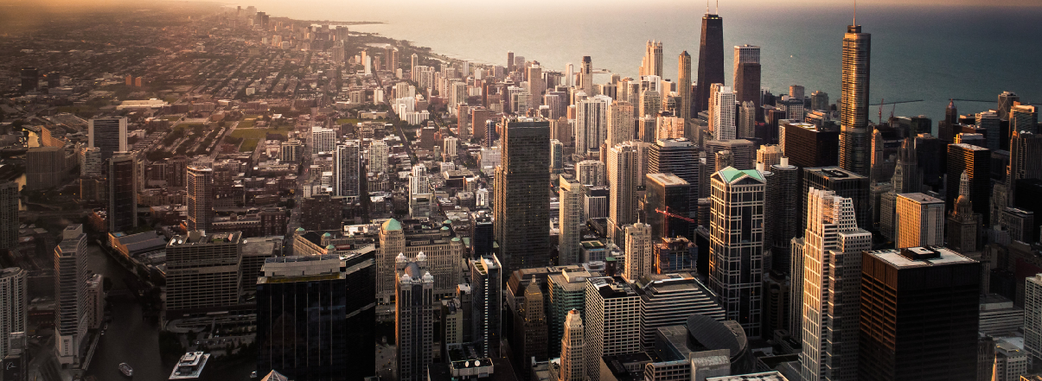
Python Presentation
第10组 黄之易 王劲草 矫健民 卢左媛 汪淑沁

Slide 2
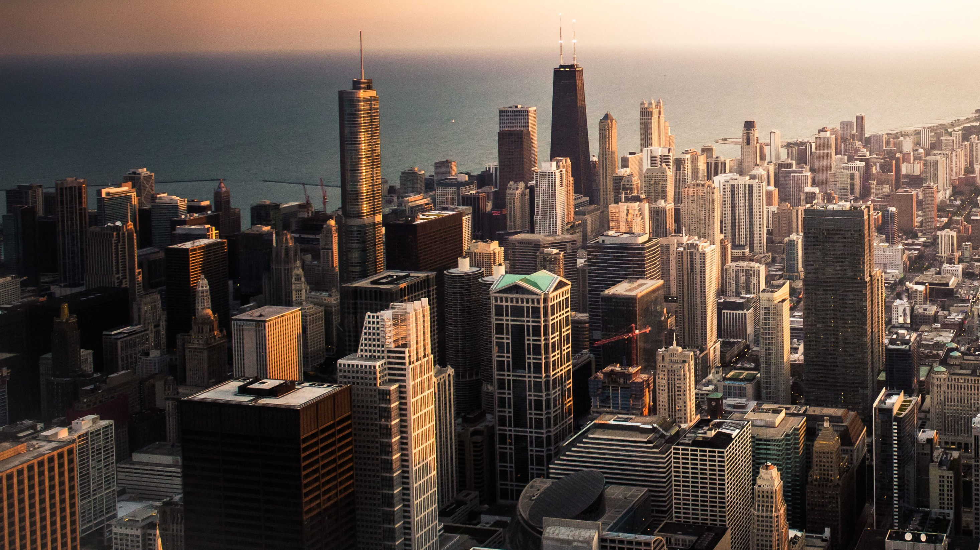
Estimation of obesity levels based on eating habits and physical condition Data Set
Content
1
Find the Question
2
Data Description
3
Data Processing
4
Data Analysis
5
Data Representation

Slide 3
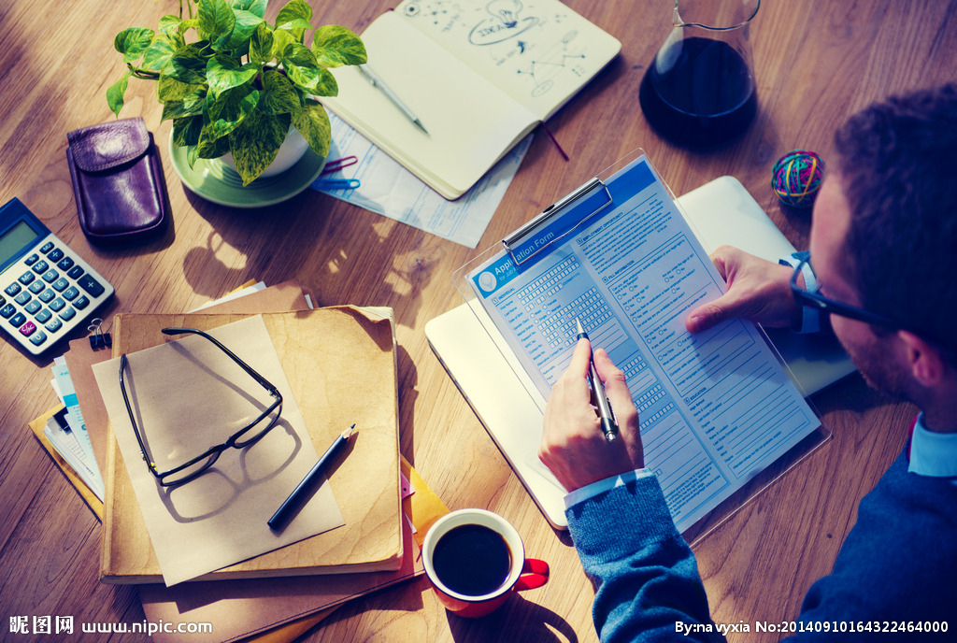
Find the question
What effects will eating habits and physical conditions do on individuals’ obesity
Data source：http://archive.ics.uci.edu/ml/datasets/Estimation+of+obesity+levels+based+on+eating+habits+and+physical+condition+

Slide 4


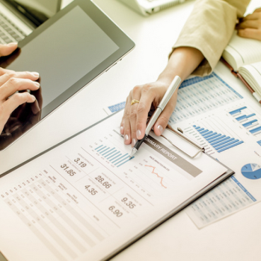
Data Description
Data characteristics
77% of the data was generated synthetically using the Weka tool and the SMOTE filter, 23% of the data was collected directly from users through a web platform
information from different locations such as Mexico, Peru and Colombia
with ages between 14 and 61 and diverse eating habits and physical condition
include 17 attributes and 2111 records

Slide 5

Data Description
Sample variable
independent variable
attributes related with eating habits
Frequent consumption of high caloric food (FAVC)
Frequency of consumption of vegetables (FCVC)
Number of main meals (NCP)
Consumption of food between meals (CAEC)
Consumption of water daily (CH20)
Consumption of alcohol (CALC)

Slide 6
Data Description
Sample variable
independent variable
attributes related with the physical condition
Calories consumption monitoring (SCC)
Physical activity frequency (FAF)
Time using technology devices (TUE)
Transportation used (MTRANS)
other variables obtained
Gender, Age, Height and Weight

Slide 7
SUMMARY OF INDEPENDENT VARIABLES
 | Question | TYPE | Possible answer
1 | What is your gender? | other variables | Female/Male
2 | what is your age? | other variables | Numeric value
3 | what is your height? | other variables | Numeric value in meters
4 | what is your weight? | other variables | Numeric value in kilograms
5 | Do you eat high caloric food frequently? | FAVC | Yes/No
6 | Do you usually eat vegetables in your meals? | FCVC | Never/Sometimes/Always
7 | How many main meals do you have daily? | NCP | Between 1 y 2/Three/More than three
8 | Do you eat any food between meals? | CAEC | No/Sometimes/Frequently/Always
9 | How much water do you drink daily? | CH20 | Less than a liter/Between 1 and 2 L/More than 2 L
10 | how often do you drink alcohol? | CALC | I do not drink/Sometimes/Frequently/Always
11 | Do you monitor the calories you eat daily? | SCC | Yes/No
12 | How often do you have physical activity? | FAF | I do not have/1 or 2 days/2 or 4 days/4 or 5 days
13 | How much time do you use technological devices such as cell phone, videogames, television, computer and others? | TUE | 0-2 hours/3-5 hours/More than 5 hours
14 | Which transportation do you usually use? | MTRANS | Automobile/Motorbike/Bike/Public Transportation/Walking

Slide 8
Data Description
Sample variable
dependent variable
Overweight Level II
Insufficient Weight
Obesity Type I
NObesity
Normal Weight
Obesity Type II
Overweight Level I
Obesity Type III

Slide 9
NObesity
Mass body index
Weight
Height*height
Classification
Underweight Less than 18.5
Normal 18.5 to 24.9
Overweight 25.0 to 29.9
Obesity I 30.0 to 34.9
Obesity II 35.0 to 39.9
Obesity III Higher than 40

Slide 10
Data Description

Slide 11



CODE
Data
Processing
Data
Analysis
Data
Representation

Slide 12
THANK YOU

